Slide 1
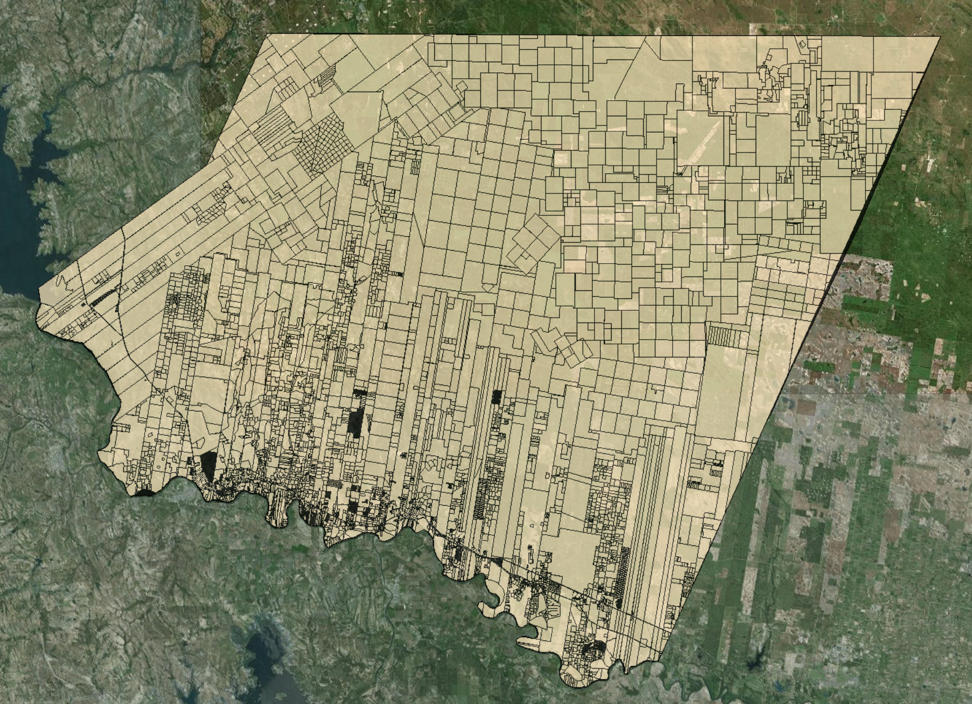
Starr County, TX
By: Jose Galvan, Nguyen Huynh

Slide 2
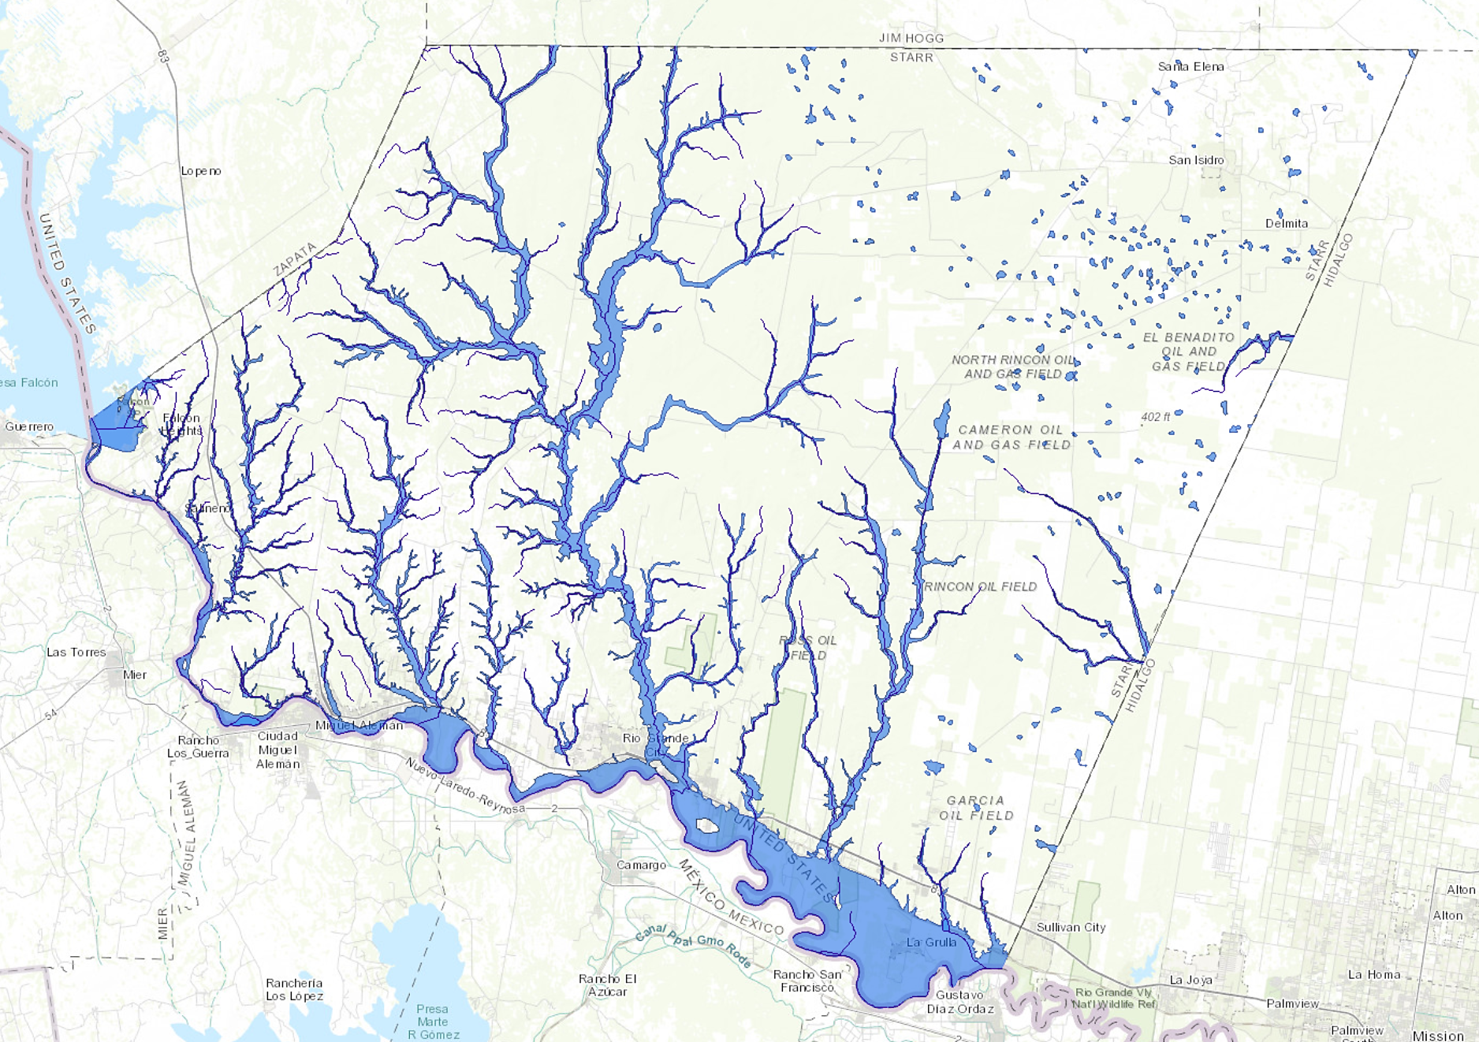
Motivation
Wanted to make a GIS map with layers representing different features of Starr County.
Costumer Mr. Gilbert Millan, City Planning Director for Rio Grande City, tasked us with making a GIS map representing Starr County to show the potential usefulness of GIS.
No clear constraints for project, other than using GIS to represent Starr County.

Slide 3
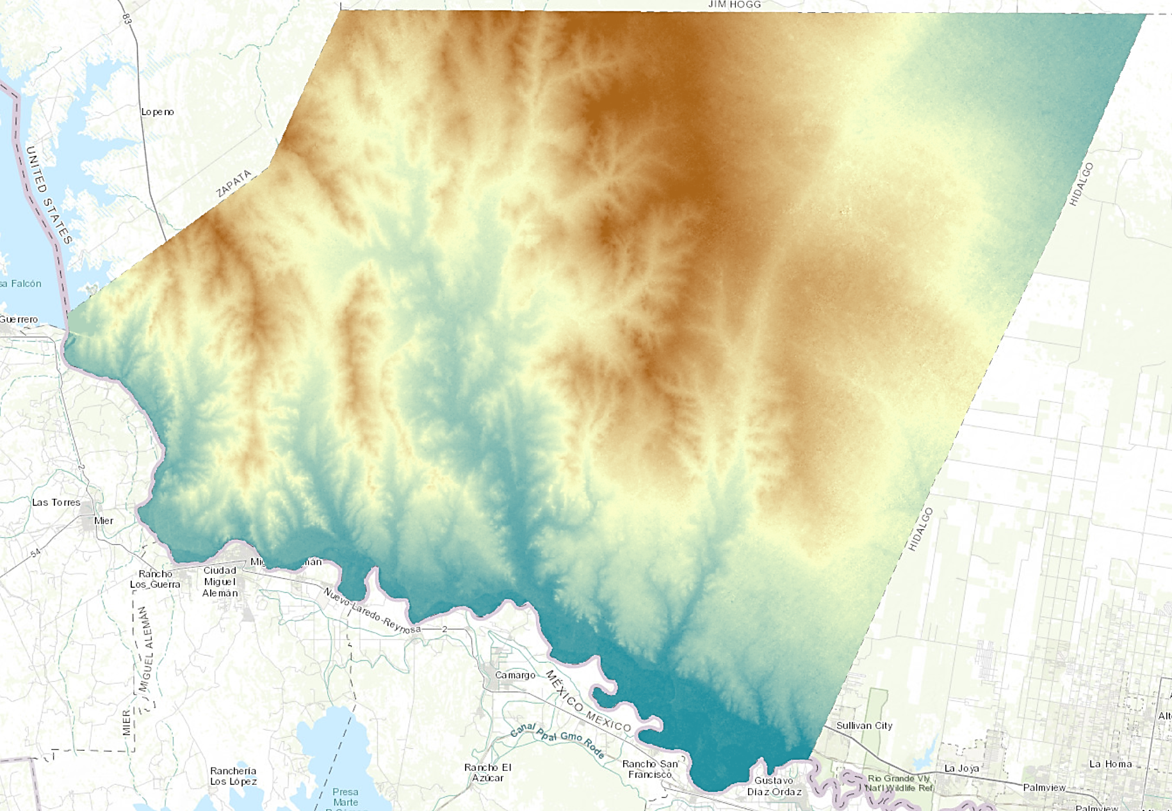
Map Design
Layer sources from USGS, US Census Bureau, US Energy Information Administration (EIA), Federal Emergency Management Agency (FEMA), and the National Land Cover Database (NLCD).
ArcMap used to edit and publish Starr County map to server. The used app builder in ArcGIS online to create final map.
Link to web map: http://tamu.maps.arcgis.com/apps/webappviewer/index.html?id=b2f3c5a7f43d451db4ecdccedc70ec72

Slide 4
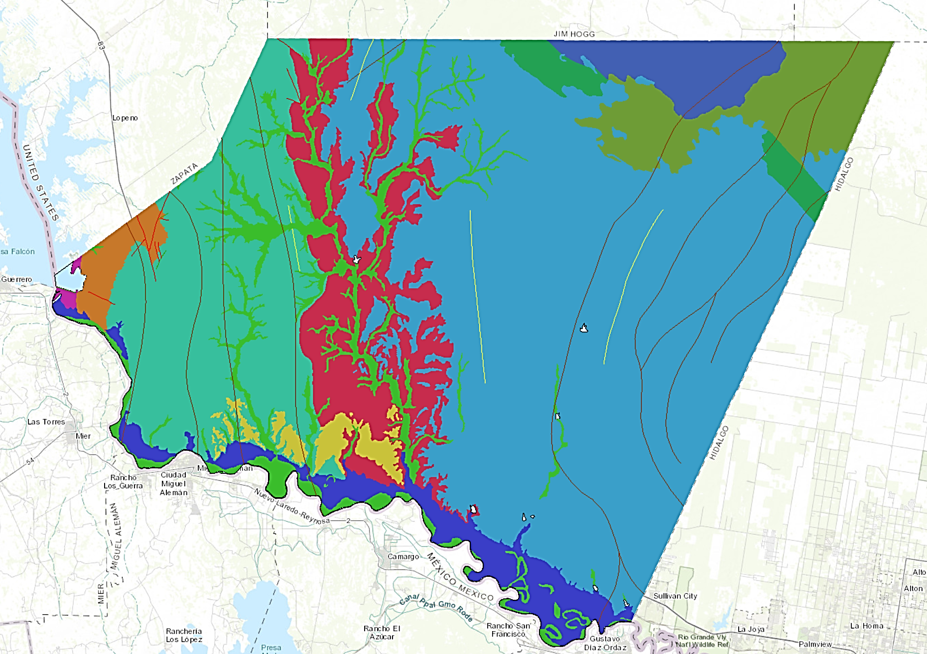
Project Challenges
Communication with costumer limited to email due to long distance.
Data gathering, sometimes servers did not let us download specific attributes within a layer.
Project idea was expanded to include more layers two weeks before due date. Original idea was to have only the Starr County parcels layer and the FEMA layers.
Need to be on Texas A&M internet connection or VPN to view GIS web map.

Slide 5
Contact Info
Jose Galvan
joeygalvan@tamu.edu
Nguyen Huynh
Nguyenhuynh@tamu.edu
Mr. Gilbert Millan City Planning Director for Rio Grande City
gmillan@cityofrgc.com

